Slide 1

Scaling Symbolic Methods Using Gradients For Neural Model Explanation
Subham S. Sahoo, Subhashini Venugopalan, Li Li, Rishabh Singh & Patrick Riley
Google Research
Presenter: Md Mahfuzur Rahman
TReNDS Center &
Dept. of Computer Science
Georgia State University

Slide 2
Use SMT to model explanations to large networks.
Use gradients information to increase scalability.
Integrated Gradients focuses on a subset of neurons in the ﬁrst layer.
The SMT constraints encode the minimal input mask discovery problem ensuring that the activations of the selected neurons are still above a threshold.
Mitigate the out-of-distribution issue as the full forward pass of the masked input isn’t present.
After solving for the minimal masks, our approach scores the mask regions to generate a relative ordering of the features within the mask.
The paper can be found here
Key Ideas

Slide 3
SMT problem is a decision problem for logical problems expressed in First-Order Logic.
SMT is a kind of constraint satisfaction problem.
Commonly used for symbolic modeling and verifying correctness of software programs Recently they have also been used for verifying properties of deep neural networks (Katz et al., 2017).
SMT Solvers in their current form are difﬁcult to scale to large networks.
Model explanation is one such domain where SMT solvers have been used but they are limited to very small sized networks (Gopinath et al., 2019).
Introduction to Satisﬁability Modulo Theory (SMT)

Slide 4
Model explanation can be viewed as Identifying a minimal set of features in a given input that is critical to a model’s prediction. Such formulation lends itself to the use of SMT solver. We can encode a neural network using real arithmetic (Katz et al., 2017) and use an SMT solver to optimize over the constraints to identify a minimal set of inputs that can explain the prediction.
SMT based model explanation

Slide 5
The minimal input is typically out of distribution.
Solving such a formulation is challenging for SMT solvers as the decision procedures for solving these constraints have exponential complexity and exacerbated for large parameters.
Typically restricted with few thousands of parameters in earlier attempts.
SMT Challenges

Slide 6
Encoding the full neural network using SMT constraints is empirically not solvable.
Use Integrated Gradients (IG) just to encode a much simpler set of linear constraints pertaining to the layer closest to the input.
Use z3 solver to solve the SMT minimization problem.
Symbolic Methods Using Gradients (SMUG)

Slide 7
First, based on the target prediction, SMUG uses gradient information propagated from the deeper layers to identify neurons that are important in the ﬁrst layer, and only encodes those.
Second, for the optimization, a set of input pixels are determined to be relevant for prediction if they can activate the neurons deemed important and maintain a fraction of their activation as the original (full) input image.
Symbolic Methods Using Gradients (SMUG)

Slide 8
This paper shows that it is possible to fully encode the minimal feature identiﬁcation problem for a small feedforward network (without gradient-based neuron selection) for MNIST, but this full SMT encoding scales poorly for even intermediate sized networks.
On ImageNet, the method performs better than Integrated Gradients and other strong baselines.
The method overcomes the issue of handling out-of-distribution samples (in case of full forward pass).
Key Findings

Slide 9
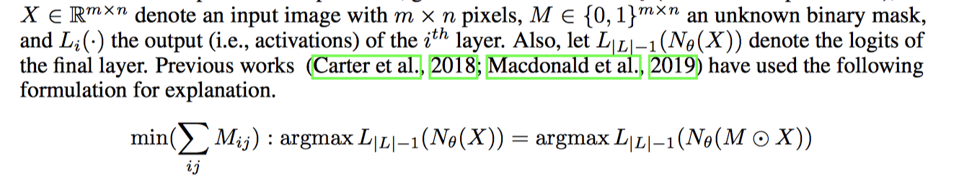
While most of the above SMT based techniques focus on verifying properties of deep networks, this work is basically focused on model explanation, in other words, where the model is looking.
Existing Formulation (Full forward pass)

Slide 10
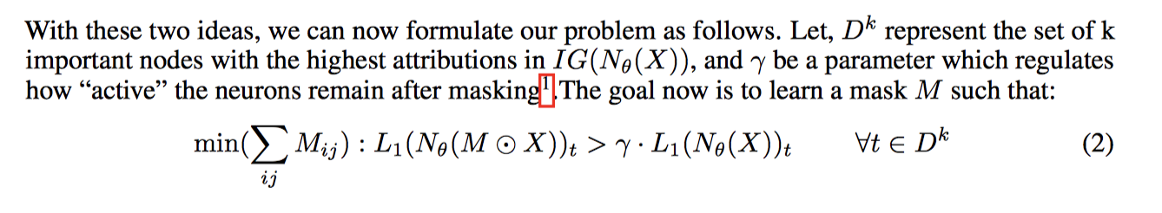
Two ideas: Use gradients attribution (IG) information 1) as a proxy for the deeper layers (for scalability), and 2) to identify a subset of neurons in the ﬁrst layer capturing information crucial for the model’s prediction
By inducing sparsity, authors removed any false positives from S. Thus, we deﬁne "relevant features" as a minimal subset of features in S that causes the nodes in Dk to remain active.
Symbolic Methods Using Gradients (SMUG)

Slide 11
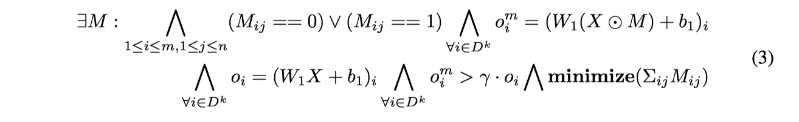
SMT Formulation: (Feedforward network)
The ﬁrst set of constraint speciﬁes that the unknown mask variable M can only have 0 and 1 as possible entries in the matrix. The second and third set of constraints encode the activation values of the ﬁrst layer of network with corresponding masked and original inputs respectively. The fourth set of constraint states that the activations of these k neurons should be at least 𝛾 times the original activation values, and the ﬁnal constraint adds the optimization constraint to minimize the sum of all the mask bits.
Minimum Subset Discovery Problem

Slide 12
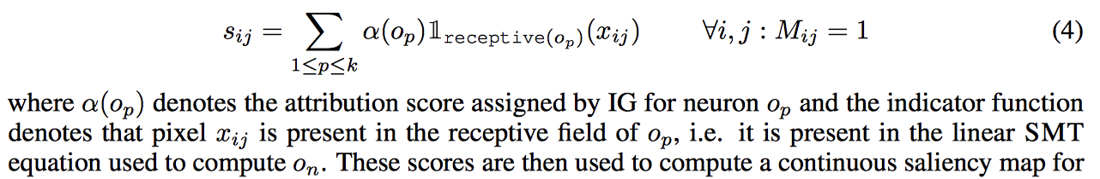
IG attribution scores for the hidden nodes in the ﬁrst layer are used to assign importance scores to mask pixels associated with that hidden node.
Saliency Map from Binary Mask

Slide 13
Existing other methods optimize their masks by doing a forward pass on perturbed images that are potentially out-of-distribution. However, SMUG performs forward pass of the masked image only till the ﬁrst layer (instead of the ﬁnal layer) to generate linear equations used in the formulation.
Handling Out-of-distribution Inputs

Slide 14
Dataset: MNIST dataset to show the scalability of the full network encoding in SMT
Network Architecture:
Feedforward model consisting of one hidden layer with 32 nodes (ReLU activation) and 10 output nodes with sigmoid, one each for 10 digits.
For 100 images chosen randomly from the validation set, the SMT solver could solve the constraint only for 41 images. For the rest 59 images, they are unknown.
Dataset: ImageNet: 3304 images (224 × 224) with ground truth bounding boxes from the validation set of ImageNet
Network Architecture:
Inception-v1
Dataset: Beer Reviews
Model:
1D CNN model to predict the rating for the aroma of the beer on a scale from 0 to 1. This model consists of a convolution layer with 128 kernels followed by a ReLU, a fully connected layer, and a sigmoid.
Metric: Log Sparsity Confidence difference score
where a is the fractional area of the rectangular cropped image and c is the conﬁdence of the classiﬁer for the true label on the cropped image.
Experimental Setup

Slide 15
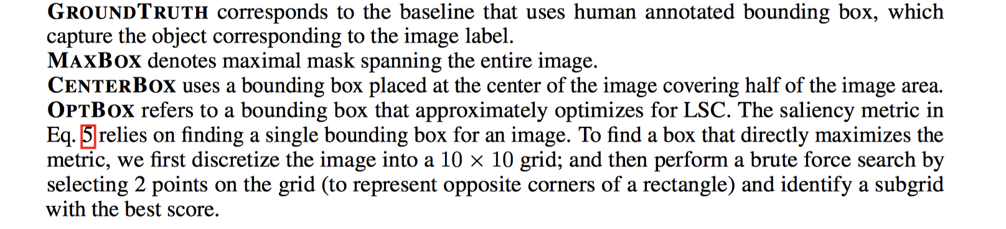
SMUG_{base} is a variant of SMUG that does not perform SMT-based minimization. In Eq. 2, set M_{ij} = 1 for each pixel x_{ij} that is in the receptive ﬁelds of the top-k neurons in the ﬁrst layer (L1 ) selected by IG.
k = 3000, γ = 0 for ImageNet, and k = 100, γ = 0 for text experiments. Further, each masking variable M_{ij} is used to represent a 4 × 4 grid of pixels (to reduce running time).
Other Baseline Methods:
IG, GRADCAM, SIS (Sufficient Input Subset), GROUNDTRUTH, MAXBOX, OPTBOX
Comparison Baselines

Slide 16
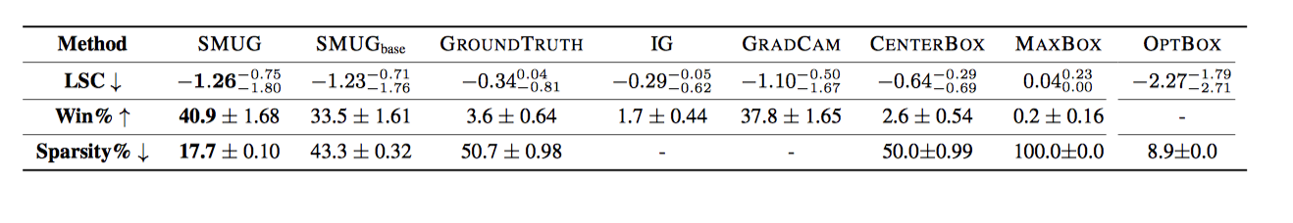
SMUG and SMUG base receive similar LSC scores which suggests that the SMT based minimization retained the relevant regions while successfully removing about 66% pixels from SMUG base.
SMUG and SMUG_{base} explanations are compact compared to IG.
Results on ImageNet

Slide 17
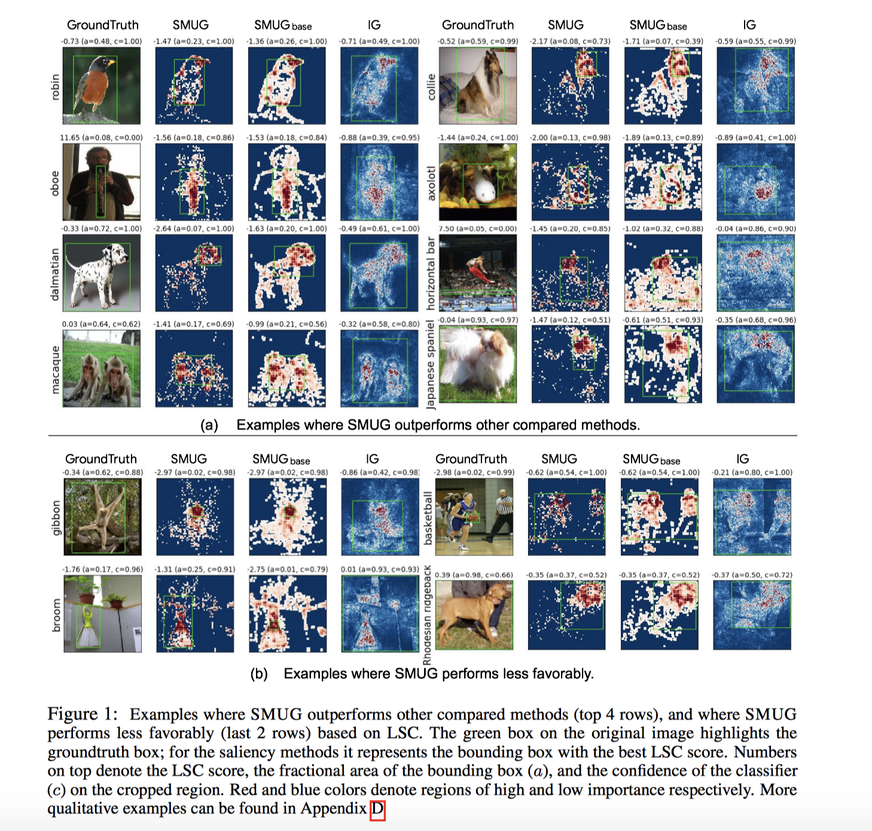

Slide 18
SMUG narrowly outperforms SMUG_{base} in terms of LSC scores.
LSC scores use the sparsity of the bounding boxes as a proxy for the sparsity of the saliency map.
The bounding boxes for SMUG and SMUG_{base} have similar sizes and hence similar LSC scores.
SMUG produces much sparser saliency maps.
The LSC scores alone don’t reveal the full picture and we need to consider the sparsity as well.
The average SMUG_{base} mask has a sparsity of 43% while the average SMUG mask has just 17%.
SMUG and SMUG_{base}- A Comparison
Notes:
IG attribution in the pixel space is known to be noisy (Smilkov et al., 2017), further attributions produced by IG depend on the choice of the baseline
the input dimensions close to the baseline receive very low attributions even though they might be important.
In fact, for any baseline, IG will be insensitive to the dimensions close to the baseline value.

Slide 19
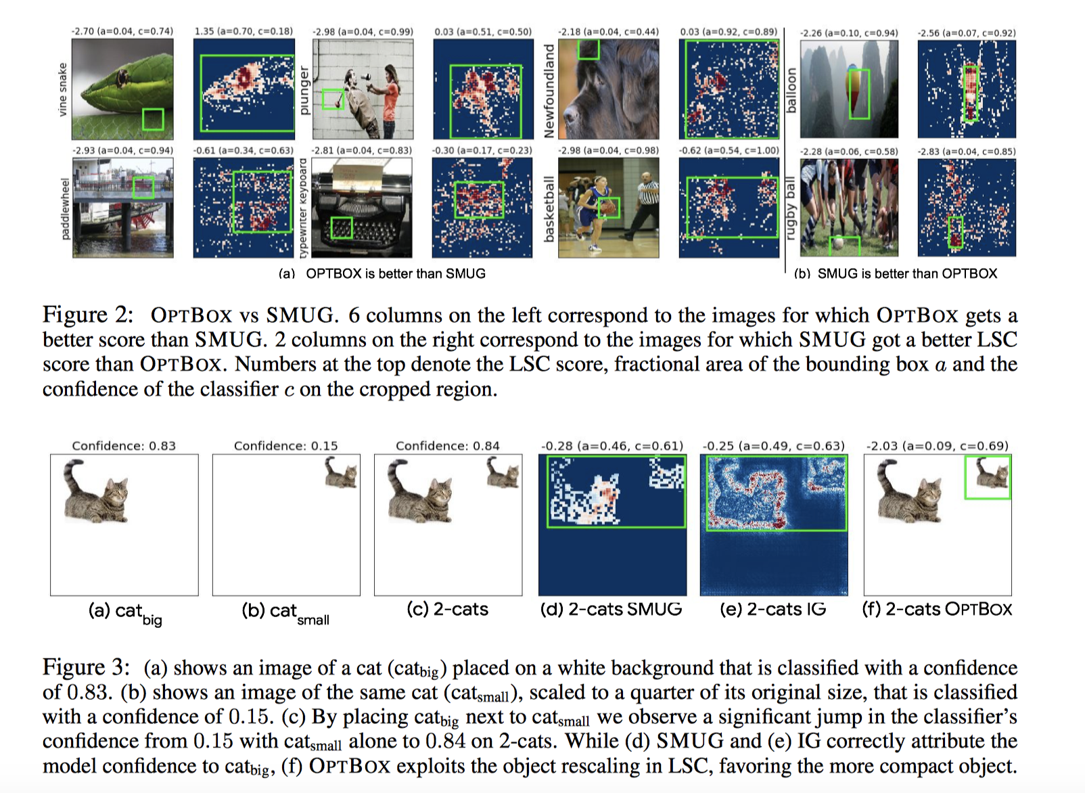
OPTBOX often ﬁnds bounding boxes that are very small, typically a sufﬁciently discriminative region or pattern in the image
OPTBOX can fool the LSC metric to favor compact regions containing redundant features.
SMUG and OPTBOX - A Comparison

Slide 20
Questions?

Slide 21
Model:
Class-specific logit:
Explanations broadly fall under two categories:
Sensitivity Methods (Gradient Methods/Saliency Maps)
Perturbation Based Approaches (Model Agnostic), also called feature importance.
Other methods include rule based, counterfactual explanations etc.
Explanation – Common Approaches
Ancona et al. 2019

Slide 22
Gradients:
Integrated
Gradients:
Explanation – Common Approaches

